Slide 1
Big Mountain Resort Increased Revenue
Justin Bell

Slide 2
Problem Statement
What opportunities exist for Big Mountain Resort to increase seasonal revenue by enough to offset the recently increased operational costs due to the addition of their new $1.54M chair lift, through either cutting down on costs without undermining ticket value or justifying higher ticket prices by the end of the upcoming season?

Slide 3
Recommendation and key findings
Our model indicates that Big Mountain Resort should increase their ticket prices by $1.99. This can only be justified if adding a run and chairlift, as well as increasing the vertical drop by 150 feet, does not exceed an increased operational cost of $1,934,638.
$81.00
$82.99

Slide 4
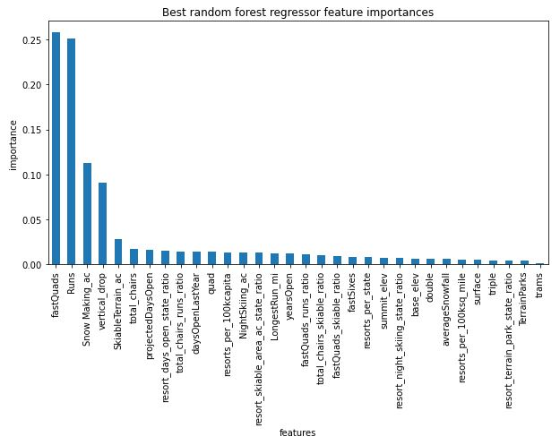
Modeling/Analysis Results
Using the model we selected, the following plot demonstrates which features are among the most important in accurately predicting ticket price.

Slide 5
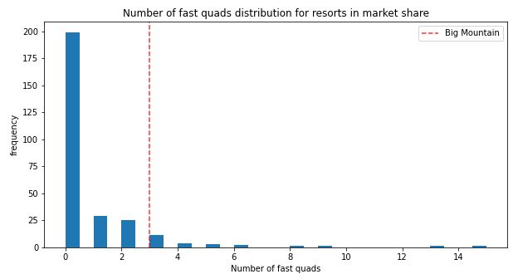
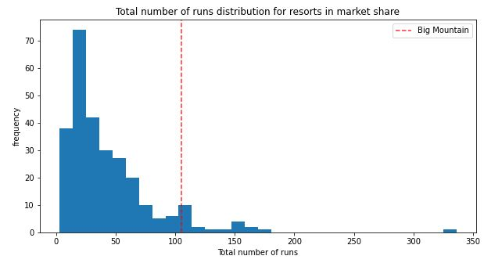
Modeling/Analysis Results
Taking a closer look at the two most important features of our model, we can see that our resort is among the top when compared to other resorts in the same market.
1
2

Slide 6
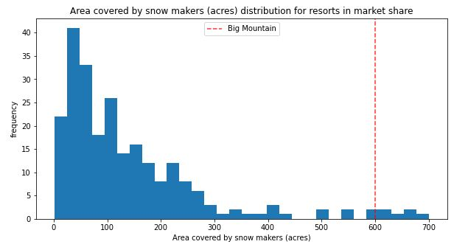
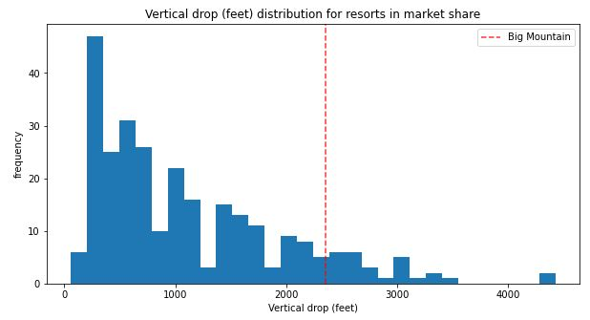
Modeling/Analysis Results
Similarly, for both the third and fourth most important features, we see our resort ahead of most others.
3
4

Slide 7
Conclusion
Big Mountain Resort should feel comfortable increasing their price to $82.99 as long as increased operational costs from the additional features recommended by our model don’t surpass the revenue gained from the increased ticket price. It would be worth looking into how operational costs influence the changes in seasonal revenue.

